Slide 1


K.Nithya Lakshmi
30-May-2023

Slide 2

Outline
Executive Summary
Introduction
Methodology
Results
Conclusion
Appendix

Slide 3
Executive Summary
Summary of methodologies
• Data collection • Data wrangling • EDA with data visualization • EDA with SQL • Building an interactive map with Folium • Building a Dashboard with Plotly Dash • Predictive analysis (Classification
Summary of all results
• EDA results • Interactive analytics • Predictive analysis

Slide 4
Introduction
Project background and context
SpaceX advertises Falcon 9 rocket launches on its website, with a cost of 62 million dollars; other providers cost upward of 165 million dollars each, much of the savings is because SpaceX can reuse the first stage
Problems you want to find answers
The project task is to predicting if the first stage of the SpaceX Falcon 9 rocket will land successfully

Slide 5

Section 1

Slide 6
Methodology
Executive Summary
Data collection methodology:
SpaceX Rest API
Web Scrapping from Wikipedia
Perform data wrangling
One Hot Encoding data fields for Machine Learning and data cleaning of null values and irrelevant columns
Perform exploratory data analysis (EDA) using visualization and SQL
Perform interactive visual analytics using Folium and Plotly Dash
Perform predictive analysis using classification models
LR, KNN, SVM, DT models have been built and evaluated for the best classifier

Slide 7
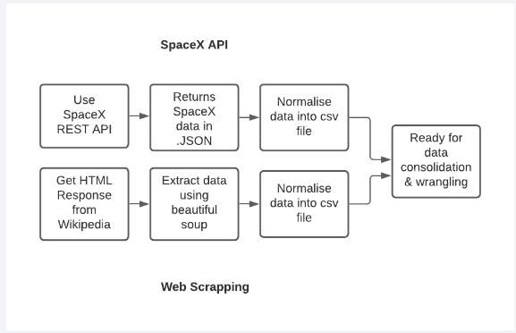
Data Collection
Describe how data sets were collected.
SpaceX launch data that is gathered from the SpaceX REST API. • This API will give us data about launches, including information about the rocket used, payload delivered, launch specifications, landing specifications, and landing outcome. • The SpaceX REST API endpoints, or URL, starts with api.spacexdata.com/v4/. • Another popular data source for obtaining Falcon 9 Launch data is web scraping Wikipedia using BeautifulSoup.

Slide 8
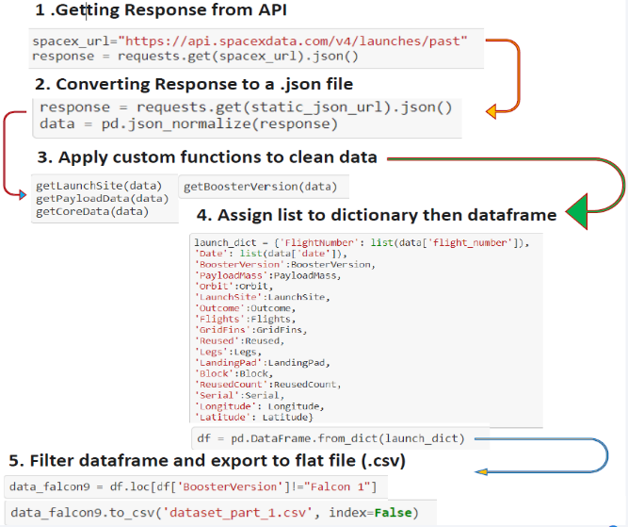
Data Collection – SpaceX API
• Data collection with SpaceX REST calls
https://github.com/knithya2k2/DS_SpacexProject/blob/main/10-IBM%20Data%20Science%20Capstone%20project.ipynb

Slide 9
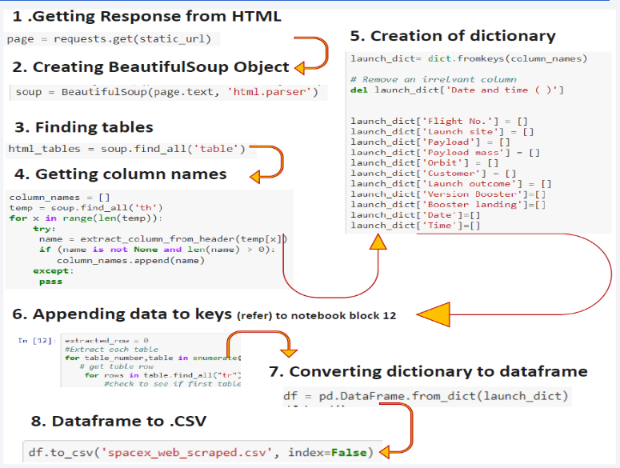
Data Collection - Scraping
Web Scrapping from Wikipedia
https://github.com/knithya2k2/DS_SpacexProject/blob/main/10-IBM%20DS%20Capstone%20project-lab2-web%20scraping.ipynb
Place your flowchart of web scraping here

Slide 10
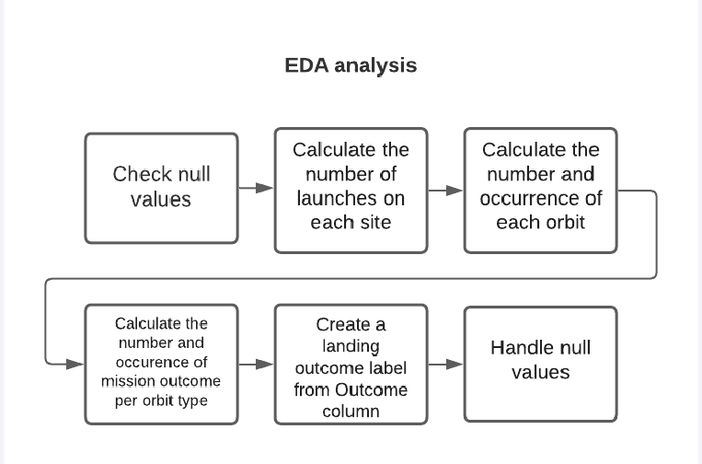
Data Wrangling
https://github.com/knithya2k2/DS_SpacexProject/blob/main/10-IBM%20DS%20Capstone%20project-lab3-EDA.ipynb

Slide 11
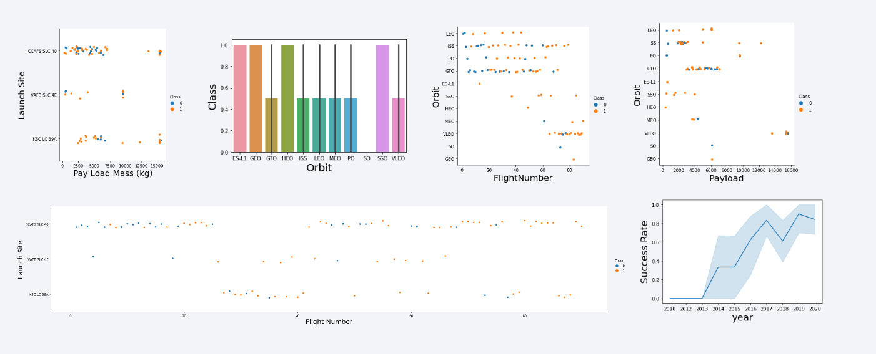
EDA with Data Visualization
https://github.com/knithya2k2/DS_SpacexProject/blob/main/10-IBM%20DS%20Capstone-lab4-EDA%20viz.ipynb

Slide 12
EDA with SQL
SQL queries performed include: • Displaying the names of the unique launch sites in the space mission • Displaying 5 records where launch sites begin with the string 'KSC’ • Displaying the total payload mass carried by boosters launched by NASA (CRS) • Displaying average payload mass carried by booster version F9 v1.1 • Listing the date where the successful landing outcome in drone ship was achieved. • Listing the names of the boosters which have success in ground pad and have payload mass greater than 4000 but less than 6000 • Listing the total number of successful and failure mission outcomes • Listing the names of the booster_versions which have carried the maximum payload mass. • Listing the records which will display the month names, successful landing_outcomes in ground pad ,booster • versions, launch_site for the months in year 2017 • Ranking the count of successful landing_outcomes between the date 2010 06 04 and 2017 03 20 in descendingorder.
https://github.com/knithya2k2/DS_SpacexProject/blob/main/10-IBM-DS%20Capstone%20project-SQL.ipynb

Slide 13
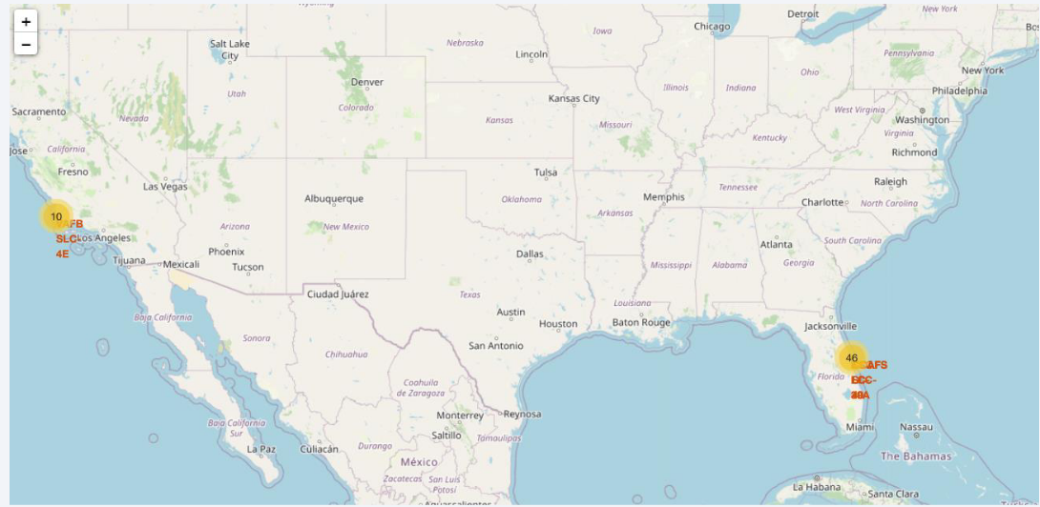
Build an Interactive Map with Folium
Map markers have been added to the map with aim to finding an optimal location for building a launch site
https://github.com/knithya2k2/DS_SpacexProject/blob/main/10-IBM%20DS%20Capstone-lab5-Folium.ipynb

Slide 14
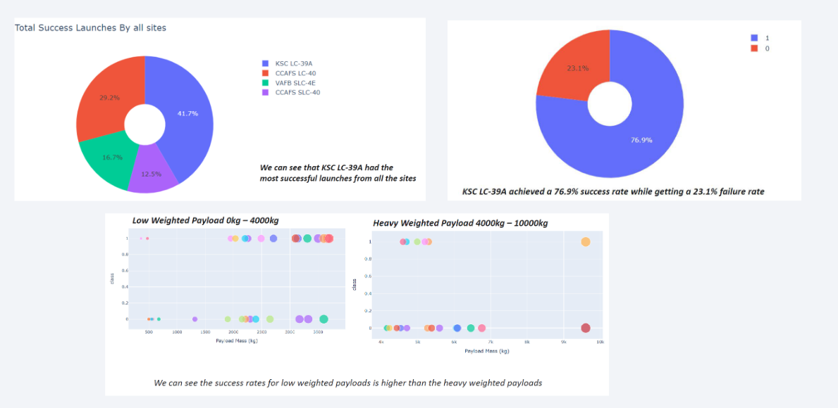
Build a Dashboard with Plotly Dash
https://github.com/knithya2k2/DS_SpacexProject/blob/main/dash_interact2_HY.py

Slide 15
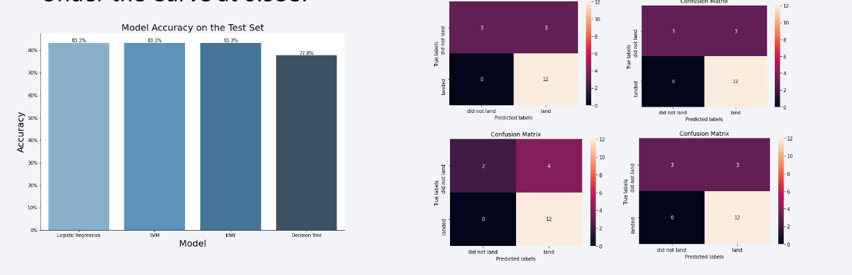
Predictive Analysis (Classification)
The SVM, KNN, and Logistic Regression model achieved the highest accuracy at 83.3%, while the SVM performs the best in terms of Area Under the Curve at 0.958.
https://github.com/knithya2k2/DS_SpacexProject/blob/main/10-IBM-DS%20capstone-lab7-ML%20prediction.ipynb

Slide 16
Results
The SVM, KNN, and Logistic Regression models are the best in terms of prediction accuracy for this dataset.
• Low weighted payloads perform better than the heavier payloads.
• The success rates for SpaceX launches is directly proportional time in years they will eventually perfect the launches.
• KSC LC 39A had the most successful launches from all the sites.
• Orbit GEO,HEO,SSO,ES L1 has the best Success Rate.
https://github.com/knithya2k2/DS_SpacexProject/blob/main/9-IBM%20Data%20Science%20Machine%20Learning%20final%20project.ipynb

Slide 17

Section 2

Slide 18
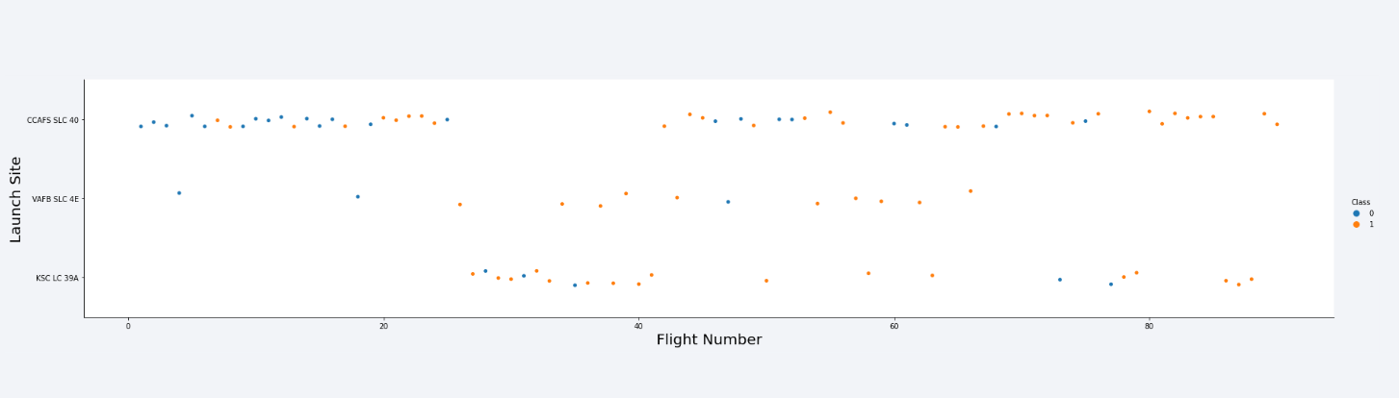
Flight Number vs. Launch Site
Launches from the site of CCAFS SLC 40 are significantly higher than launches form other sites.

Slide 19
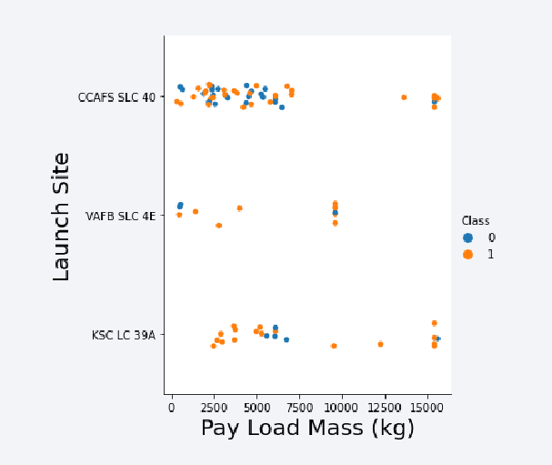
Payload vs. Launch Site
• The majority of lPay Loads with lower Mass have been launched from CCAFS SLC 40.

Slide 20
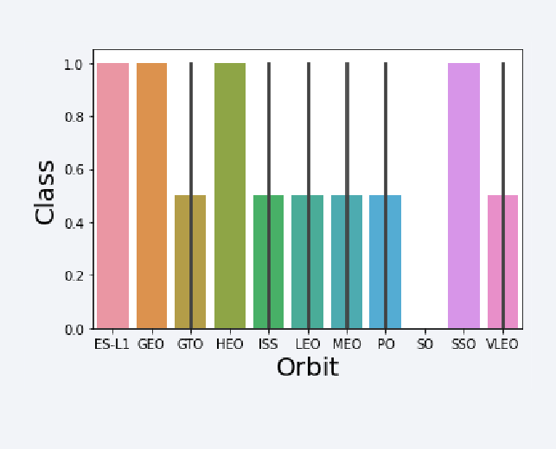
Success Rate vs. Orbit Type
The orbit types of ES-L1, GEO, HEO, SSO are among the highest success rate.

Slide 21
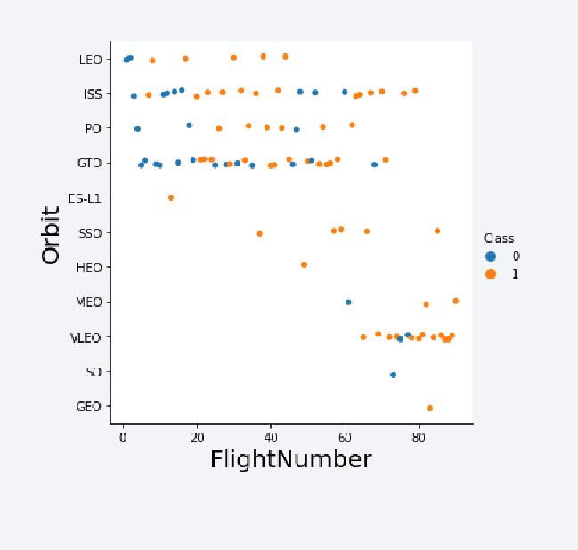
Flight Number vs. Orbit Type
• A trend can be observed of shifting to VLEO launches in recent years.

Slide 22
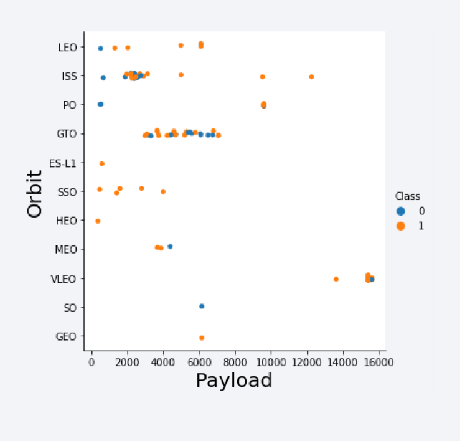
Payload vs. Orbit Type
There are strong correlation between ISS and Payload at the range around 2000, as well as between GTO and the range of 4000-8000.

Slide 23
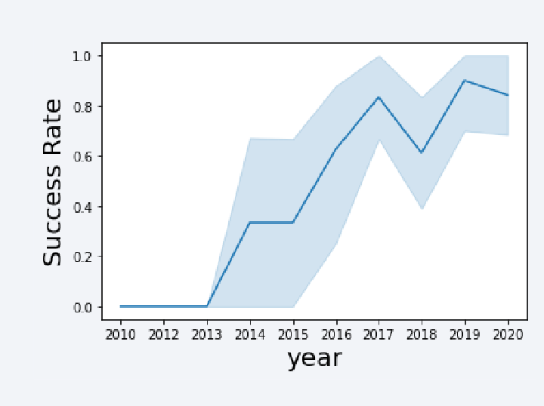
Launch Success Yearly Trend
Launch success rate has increased significantly since 2013 and has stablised since 2019, potentially due to advance in technology and lessons learned.

Slide 24
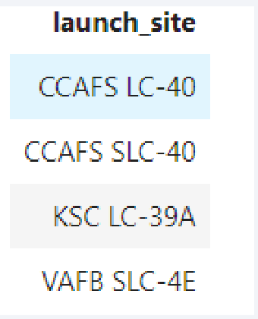
All Launch Site Names
%sql select distinct(LAUNCH_SITE) from SPACEXTBL

Slide 25
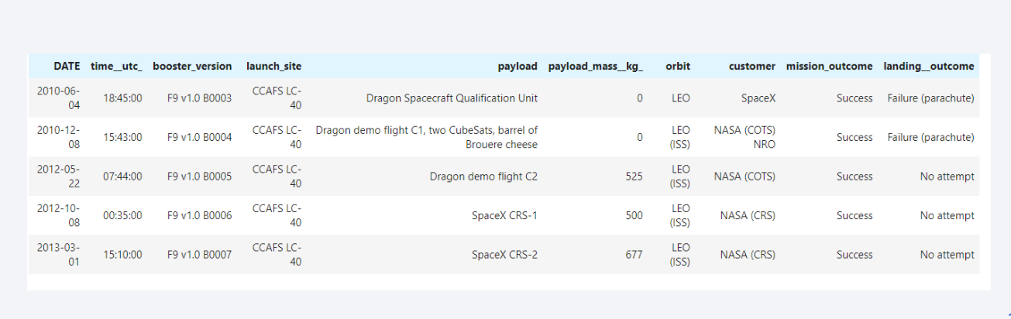
Launch Site Names Begin with 'CCA'
%sql select * from SPACEXTBL where LAUNCH_SITE like 'CCA%' limit 5

Slide 26
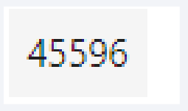
Total Payload Mass
%sql select sum(PAYLOAD_MASS__KG_) from SPACEXTBL where CUSTOMER = 'NASA (CRS)'

Slide 27
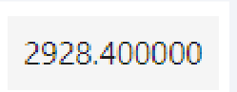
Average Payload Mass by F9 v1.1
• %sql select avg(PAYLOAD_MASS__KG_) from SPACEXTBL where BOOSTER_VERSION = 'F9 v1.1'

Slide 28
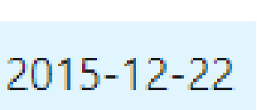
First Successful Ground Landing Date
• %sql select min(DATE) from SPACEXTBL where Landing__Outcome = 'Success (ground pad)'

Slide 29
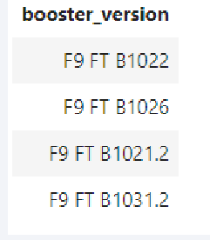
Successful Drone Ship Landing with Payload between 4000 and 6000
%sql select BOOSTER_VERSION from SPACEXTBL where Landing__Outcome = 'Success (drone ship)' and PAYLOAD_MASS__KG_ > 4000 and PAYLOAD_MASS__KG_ < 6000

Slide 30

Total Number of Successful and Failure Mission Outcomes
%sql select count(MISSION_OUTCOME) from SPACEXTBL where MISSION_OUTCOME = 'Success' or MISSION_OUTCOME = 'Failure (in flight)'

Slide 31
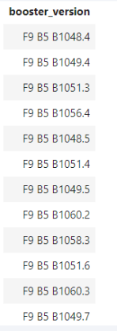
Boosters Carried Maximum Payload
%sql select BOOSTER_VERSION from SPACEXTBL where PAYLOAD_MASS__KG_ = (select max(PAYLOAD_MASS__KG_) from SPACEXTBL)

Slide 32
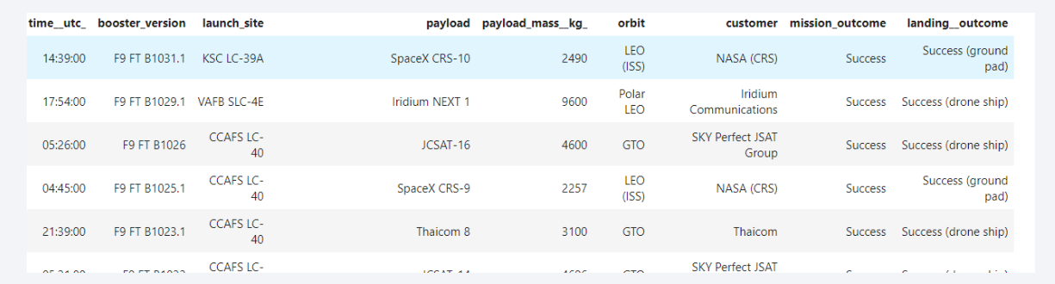
2015 Launch Records
%sql select * from SPACEXTBL where Landing__Outcome like 'Success%' and (DATE between ‘2015-01-01' and ‘2015-12-31') order by date desc

Slide 33
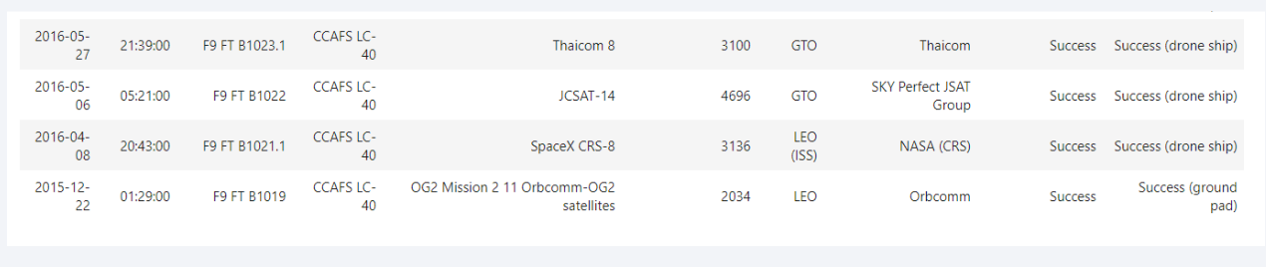
Rank Landing Outcomes Between 2010-06-04 and 2017-03-20
%sql select * from SPACEXTBL where Landing__Outcome like 'Success%' and (DATE between '2010-06-04' and '2017-03-20') order by date desc

Slide 34

Section 3

Slide 35
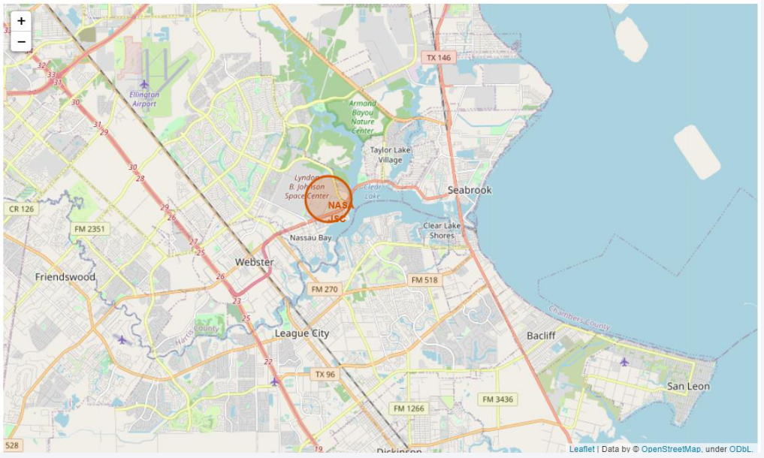
All launch sites marked on a map

Slide 36
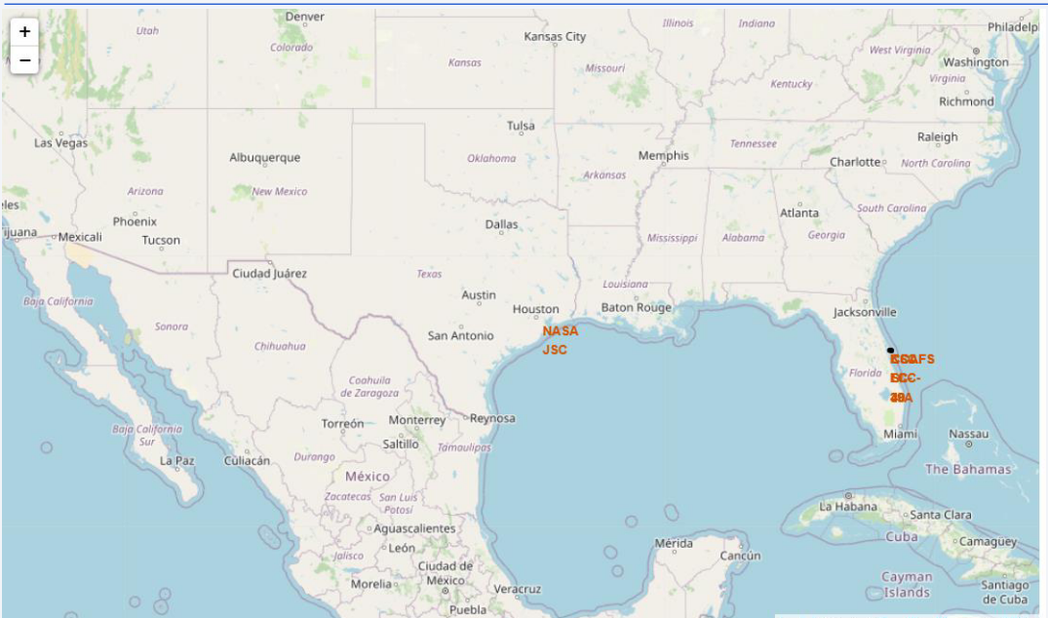
Success/failed launches marked on the map

Slide 37
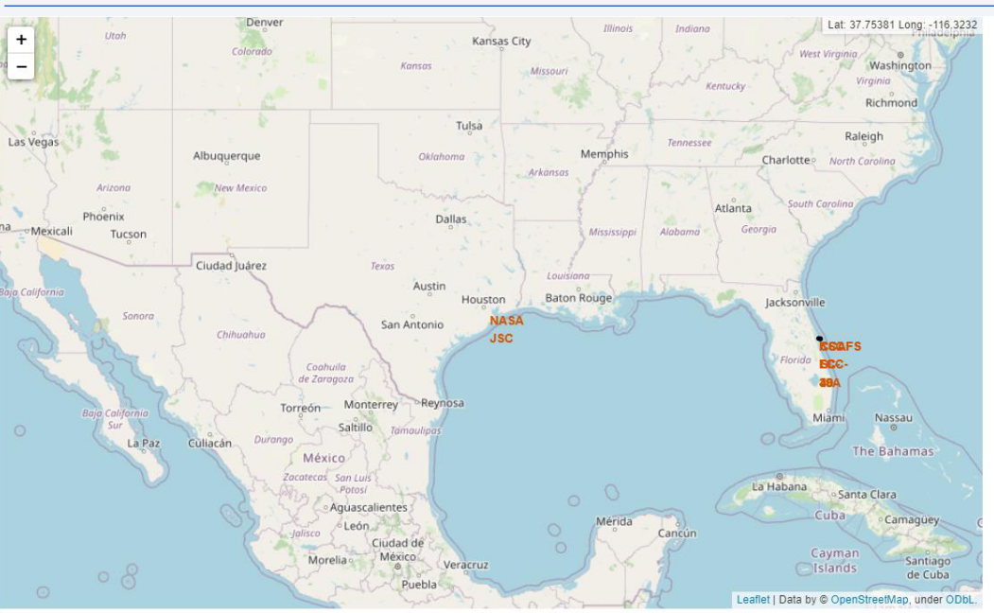
Distances between a launch site to its proximities

Slide 38

Section 4

Slide 39
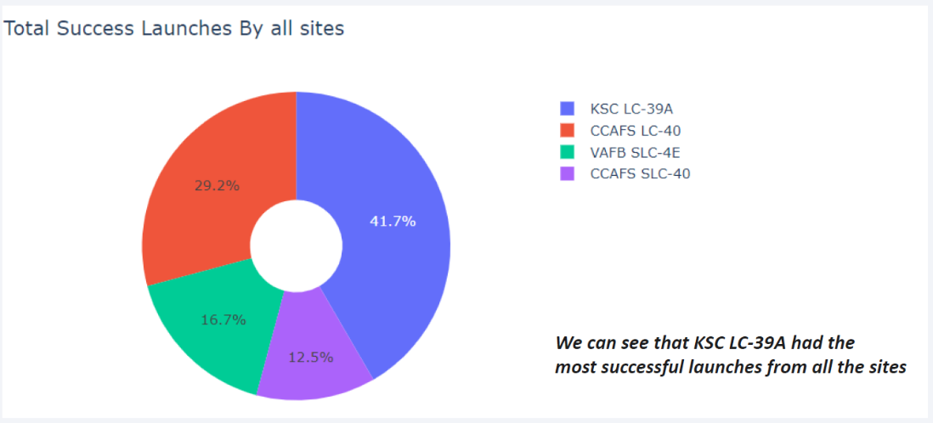
Total success launches by all sites

Slide 40
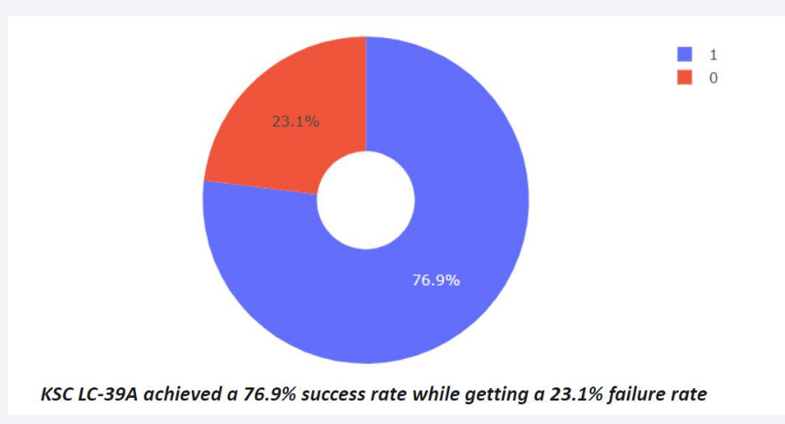
Success rate by site

Slide 41
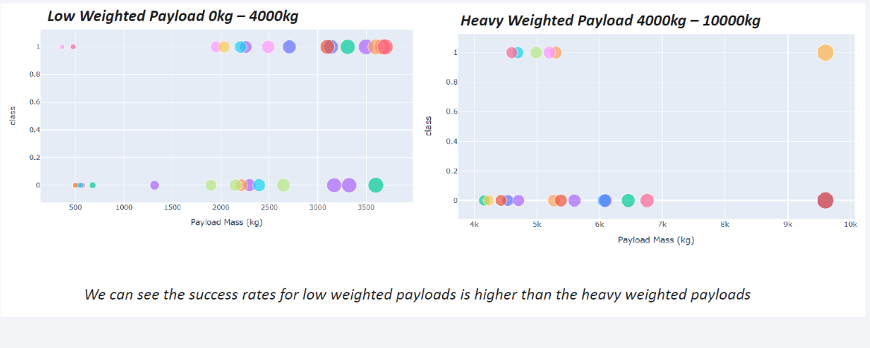
Payload vs launch outcome

Slide 42

Section 5

Slide 43
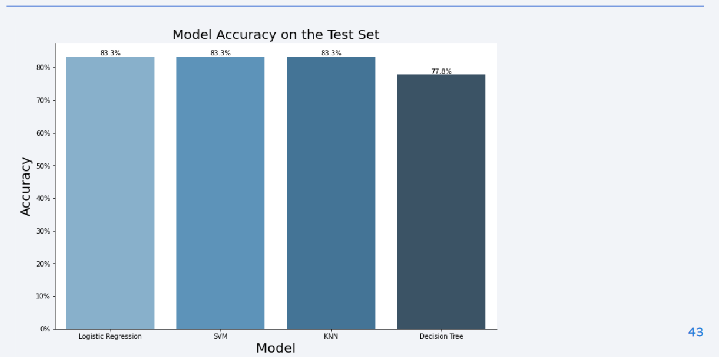
Classification Accuracy

Slide 44
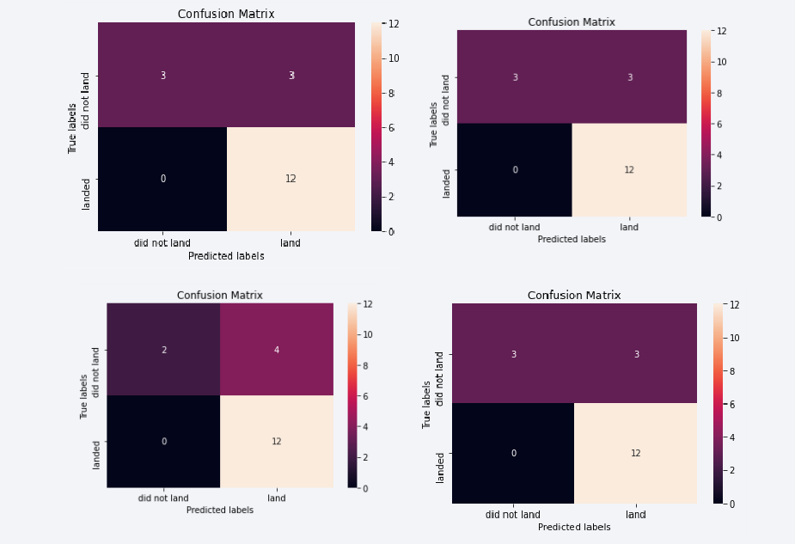
Confusion Matrix

Slide 45
Conclusions
The SVM, KNN, and Logistic Regression models are the best in terms of prediction accuracy for this dataset. • Low weighted payloads perform better than the heavier payloads. • The success rates for SpaceX launches is directly proportional time in years they will eventually perfect the launches. • KSC LC 39A had the most successful launches from all the sites. • Orbit GEO,HEO,SSO,ES L1 has the best Success Rate.

Slide 46
Appendix
https://github.com/knithya2k2/DS_SpacexProject/blob/main/9-IBM%20Data%20Science%20Machine%20Learning%20final%20project.ipynb

Slide 47


